Slide 1
COVER LETTER

Slide 2
Cover Letter
A job application letter/cover letter is written to apply for a specific position.
It has three functions:
To tell the applicant’s talents to a prospective employer
To persuade the reader to believe in his/her suitability for a particular position
A self-promotion instrument

Slide 3
Purpose
Introduces the applicant to the hiring organisation
Introduces the applicant’s resume
Highlights the applicants positive personal traits and achievements
Shows how the applicants special talents will benefit the organisation
Emphasises how the applicant is right for the job by matching the requirements of the job with his/her qualifications
Asks for an opportunity to be interviewed by the organisation

Slide 4
Key Elements
(1) gaining the reader’s attention
(2) building the reader’s interest in the applicant’s candidature
(3) convincing the reader that the applicant is the best candidate
(4) motivating the reader to act

Slide 5
Parts of the Letter
Opening that gains the reader’s attention.
Body that builds the reader’s interest convinces the reader that the applicant is the best candidate.
Closing that motivates the reader to act.
Cover letters through e-mails are more common.

Slide 6
Opening: Solicited Application Letters
Solicited Application Letters: A letter of application for a job that has been advertised:
Mentioning Source of Information: I am writing in response to your advertisement in the Opportunities section of your company’s website, for software professionals for your development centre at Kolkata.
Matching Credentials to Employer Needs: As a software engineer having more than six years of experience in an IT organisation, with extensive exposure to design, development, and testing, I would be able to contribute to the growth and development of your company.

Slide 7
Opening: Unsolicited Application Letters
Unsolicited Application Letters: When a job is not advertised and the applicant is writing to explore possible openings.
Example: Since Zafin Labs is a global leader in product innovation solutions targeted towards revenue recognition and revenue generation, it may need high calibre IT professionals who can efficiently handle both offshore and onsite projects in coordination with its global clients. As a quality engineer with eight years of experience in software functional and system level testing policies and procedures, I would be able to contribute to the growth of Zafin’s Offshore Development Centre at Kolkata.

Slide 8
Body
Qualifications and Experience: Five years of formal professional training that includes B Tech in Electronics from Delhi College of Engineering and a Post Graduate Diploma in Engineering Management from the Indian Institute for Production Management, Rourkela. Two years of experience as a Sales Engineer at Micro Systems and Controls, Kolkata.
Highlight Your Strengths and Describe Capabilities: Strong in consulting and communication skills with the ability to interact with clients at all levels, demonstrated through strong influencing and negotiation skills.

Slide 9
Closing
Refer to the Résumé: The details of my education, training, and experiences are outlined in the enclosed resume.
Restate Interest in the Company or Reinforce Suitability for the Position: I believe I do possess all the qualifications and skills needed to meet the challenges of a System Administrator in your firm.
Express Eagerness to Meet the Employer or Directly Ask for an Interview: I look forward to having the opportunity to talk with you at your convenience, about the Project Execution Engineer position.

Slide 10
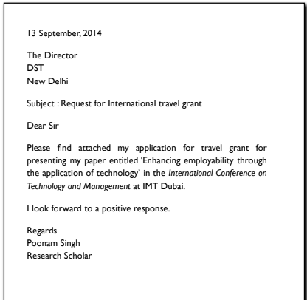
Cover letter for travel grant request

Slide 11
